Slide 1
Lilian Rodrigues
Twitter Clone
Web Development/FullStack – ReDi School Berlin, Spring Semester 2025

Slide 2
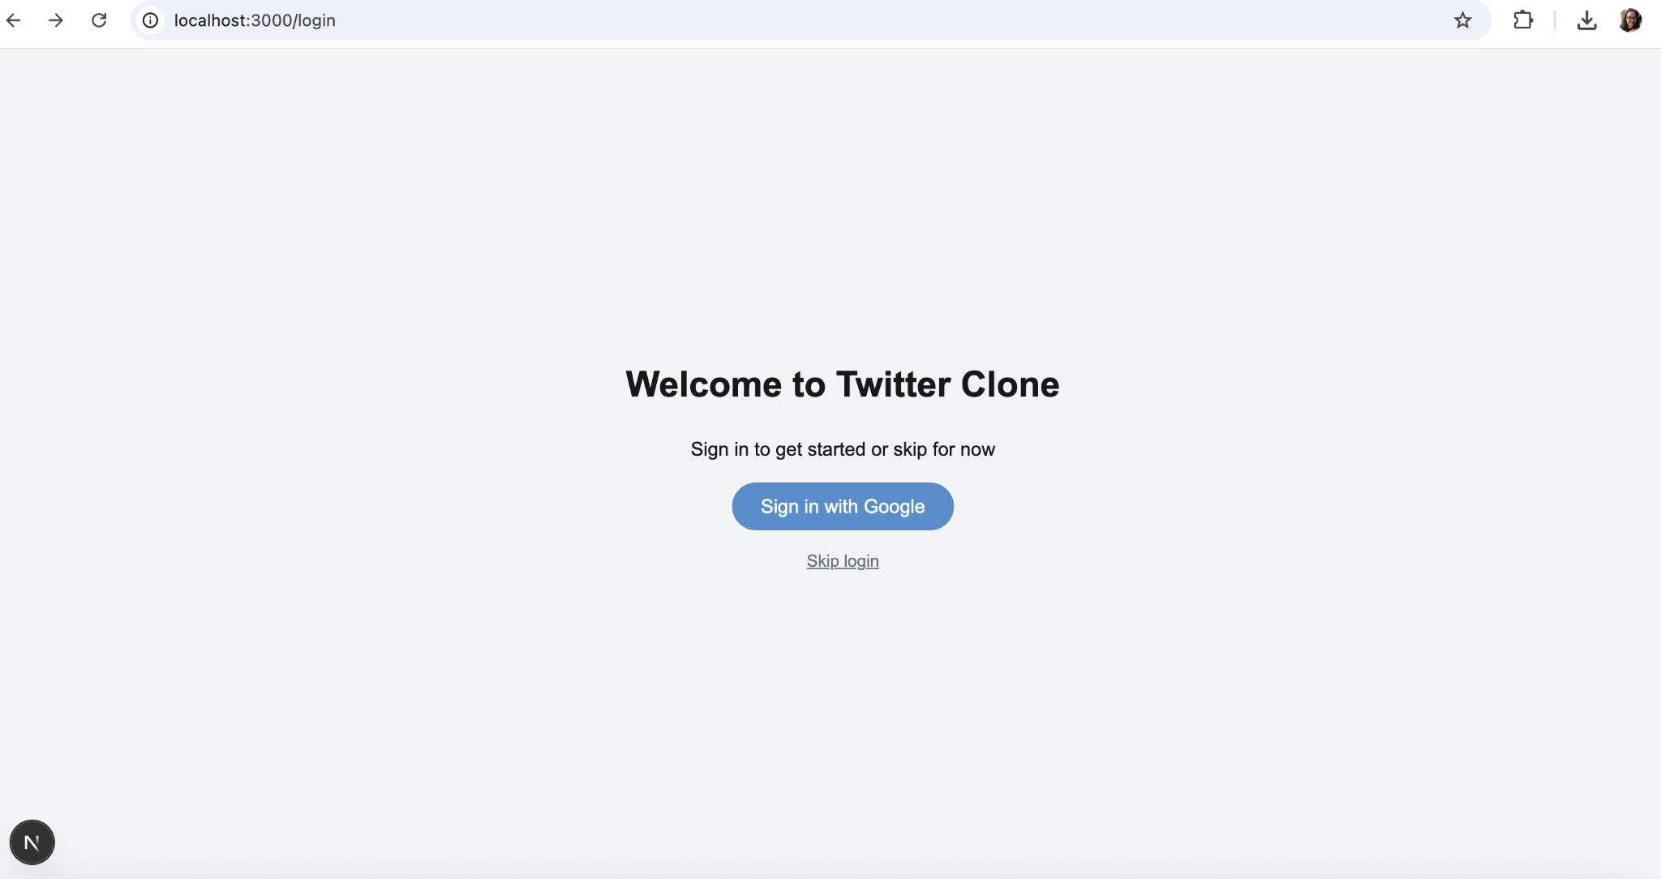
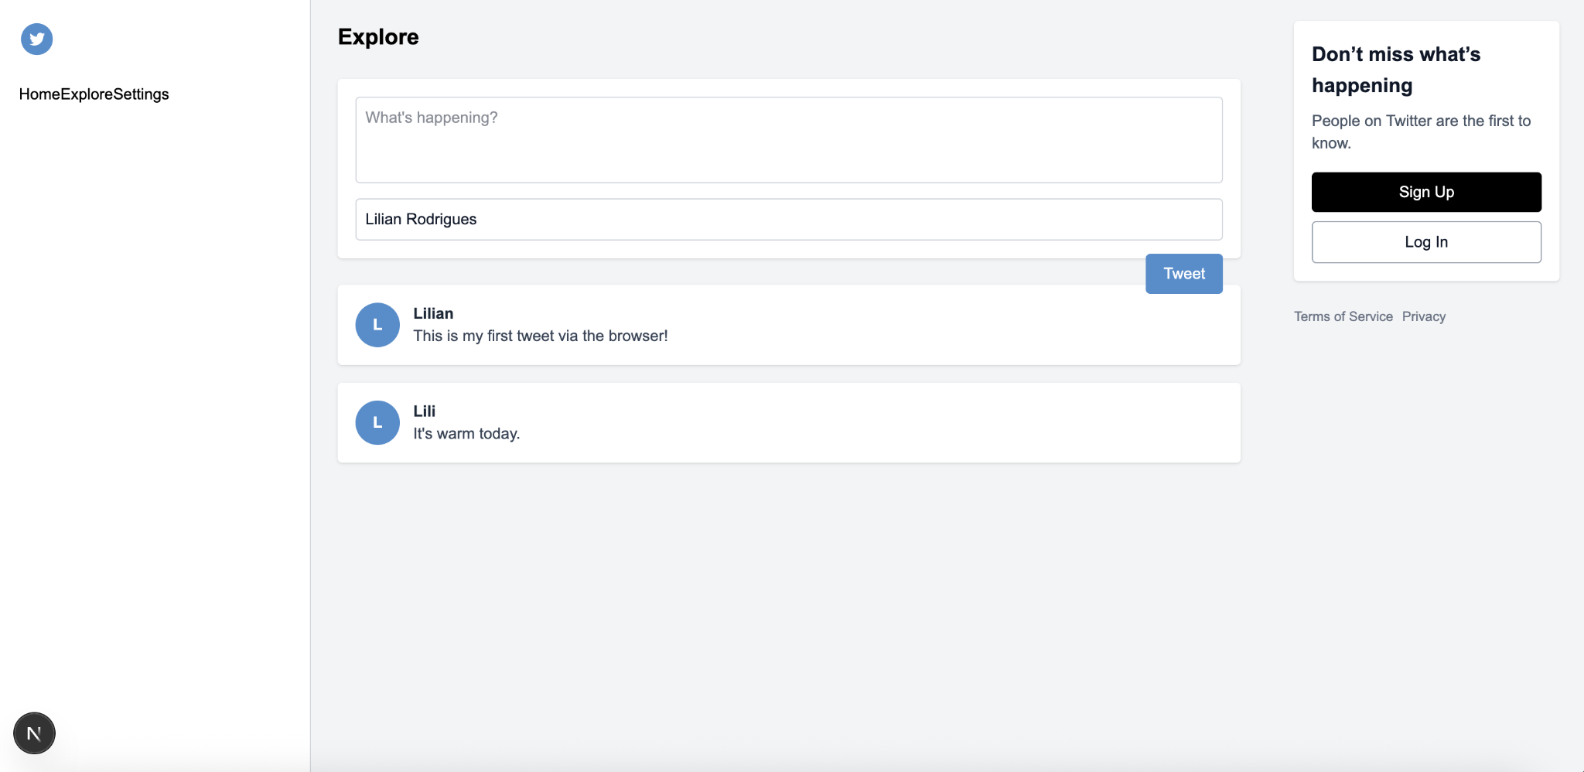
Introduction
This project is a simplified clone of Twitter, built with modern web technologies. It replicates the core functionalities of the platform—like posting tweets and user authentication—focusing on accessibility, clean design, and practical user flow.
Instead of building a mobile version, the focus was on delivering a solid and responsive desktop experience.

Slide 3
The goal was to apply everything I learned in the FullStack track—Next.js, Tailwind CSS, MongoDB, and authentication systems—into a real-world inspired app. I chose Twitter as the model because it's a familiar and widely-used platform that showcases common web app features such as:
Posting and viewing data (tweets)
Authenticating users with Google login
Persisting user-generated content Designing a clean and intuitive UI
Purpose & Motivation

Slide 4
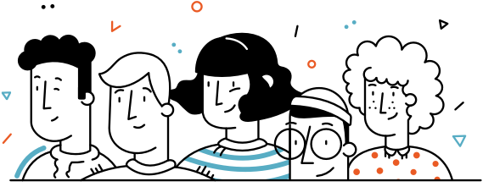
Some key features include:
Tweet Posting: Users can post messages to a shared timeline.
Google Authentication: Sign in securely via Google using next-auth.
Database Integration: Tweets are stored in MongoDB and persist after reloads.
User Avatar Color Generator: Auto-generates a colored avatar based on the first letter of a user’s name.
Minimal UI: Inspired by Twitter, with a soft custom blue (#598DCA) for branding.
Authentication Redirect: Users are required to log in to post or interact.
Reusable Components: Components like Sidebar, TweetCard, and Modal are modular and reusable.

Slide 5
Technology Stack
Next.js – for full-stack React development
Tailwind CSS – for styling and layout
MongoDB – for persistent data storage
next-auth – for user login and session handling
Vercel – for deployment
GitHub – for version control and collaboration

Slide 6
Conclusion & Next Steps
Conclusion & Next Steps
This Twitter Clone project helped me gain con
fidence working with the full modern stack. It demonstrated how to combine backend and frontend logic and taught me how to debug real-world deployment issues.For future improvements, I would consider:
Adding tweet deletion
Styling improvements Admin-only tweet moderation
User profile editing
Authentication Setup: Setting up next-auth required configuring routes and integrating environment variables correctly.
Deployment Issues: Solving GitHub integration and Vercel deployment errors, including Git submodules and missing dependencies.
Component Communication: Managing state across multiple components (e.g., passing tweet data and modals) took some trial and error. Build Errors: Fixed build-breaking errors related to outdated or misplaced files (e.g., TypeScript remnants).

Slide 7
Thank you!

